Slide 1
Shaker Life and Culture
“A Day No Pigs Would Die”

Slide 2
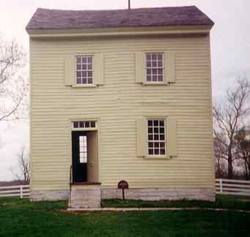
The Shaker culture and lifestyle embodied simplicity, religion, peace and music.

Slide 3
Who are the Shakers?
Shakers were originally Quakers, and then branched off into their own culture and religion.
They became known as the Shakers due to the intensity of their religious experiences, often shaking when praying or meditating.
Their religion became their culture.

Slide 4
How they started
The Shakers emigrated to America from Manchester, England in search of religious freedom in 1774.
They sheltered themselves from others. At the most, they were seen in small communities of the northeastern states, where the largest was only 300 members.

Slide 5
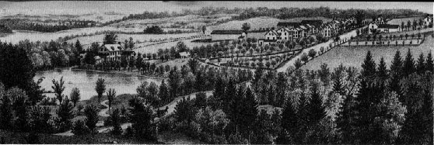
Shaker Community

Slide 6
Shaker Music
Shaker tunes were both simple and sing-able.
Like their religion, Shaker music has always been a central aspect of their culture.
Their music typically uses two forms; the Shaker Hymn and the Shaker Song.
Shaker hymns often have only the second section repeated, or A//BB. Shaker songs have at least two verses, and in several cases the verses number over a dozen.

Slide 7
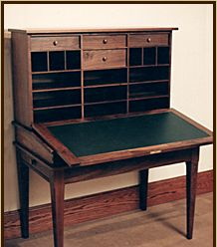
Remembered for…
These days, the Shakers are remembered for their fine crafts and furniture. Like the functional design of their furniture, their music employed the same simplicity, care, and skill.

